Slide 1
Selling DNN
Tycho de Waard
Tjep’s digital agency
Tycho@tjeps.com

Slide 2
Please support our valuable sponsors
Notes:
Without sponsors this event would not exist. So, if you’re up here: many thanks! If you’re not: consider a sponsorship next year ☺

Slide 3
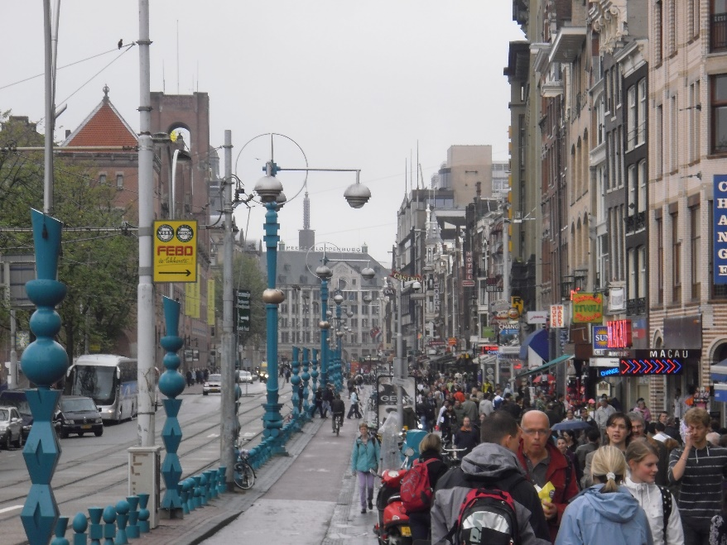
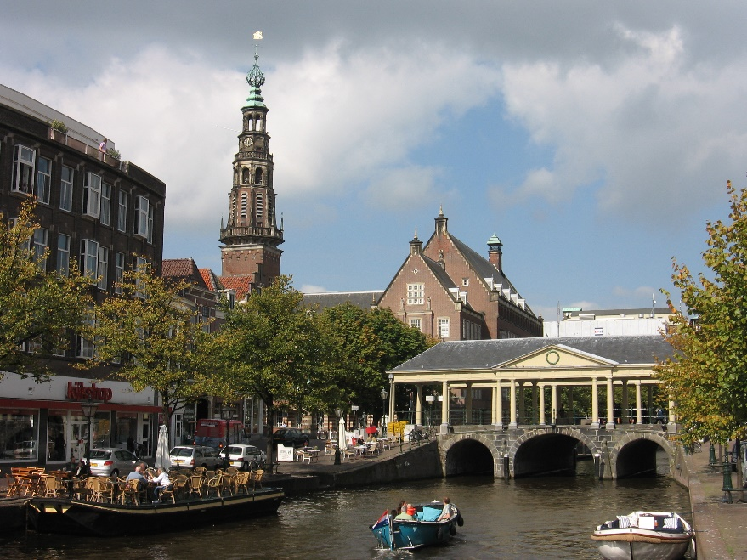
Tjep’s digital agency, The Netherlands

Slide 4
About me
Experience:
Editing, online marketing, corporate sites, e-commerce, accountmanagement, pitches, strategy, coaching editors, Drupal, DNN, Wordpress, Magento, custom CMS, Moodle…

Slide 5
This session
CMS landscape (WCMS / WMS / ECM…etc)
Know thy enemy
Buying audience (DMU)
Offer
Curve ball
NLP

Slide 6
Perfection is a lot of simple things done right
- Marco Pierre White

Slide 7
CMS landscape
Market shares
Analysis / trends
New competition

Slide 8
Market shares
1. Wordpress (59%)
2. Joomla (7%)
3. Drupal (4,7%)
7. TYPO3 (1,5%)
10. Squarespace (1,2%)
14. Wix (0,7%)
17. DNN (0,5%)
18. Sitefinity (0,5%)
21. Weebly (0,4%)
34. Sitecore (0,2%)
35. Kentico (0,2%)
75. Umbraco (0,1%)
91. Episerver (<0.1%)

Slide 9
Market shares
1. Wordpress (59%)
2. Joomla (7%)
3. Drupal (4,7%)
7. TYPO3 (1,5%)
10. Squarespace (1,2%)
14. Wix (0,7%)
17. DNN (0,5%)
18. Sitefinity (0,5%)
21. Weebly (0,4%)
34. Sitecore (0,2%)
35. Kentico (0,2%)
75. Umbraco (0,1%)
91. Episerver (<0.1%)

Slide 10
Trend
CMS | 2010 | 2017
Wordpress | 54,3% | 59%
Joomla | 9,5% | 6,9%
Drupal | 6,5% | 4,7%
TYPO3 | 2% | 1,5%
Squarespace | 0,2% | 1,2%
Wix | <0,1 | 0,7%
DNN | 0,8% | 0,5%
Sitefinity | 0,2% | 0,5%
Sharepoint | 0,6% | 0,3%
Sitecore | - | 0,2%
Kentico | 0,1% | 0,2%
Umbraco | 0,3 | 0,1

Slide 11
Analysis
Wordpress domination
DNN highest .NET CMS
Old stuff (front page) lingering
2% is .NET
DNN
Sitefinity
Sharepoint
Sitecore
Kentico
nopCommerce
Ektron (now EPIserver)
Umbraco
Orchard
EPIserver

Slide 12
2 major trends advanced CMS
Richer functionality
Personas
Smart content
Multi channel
Online marketingsupport
Connecting third party
360 degree visitor / customer view
Headless CMS / decoupled CMS / API

Slide 13
New competition
Business extension
Salesforce: portal experience
Website builders
Wix, Weebly, Squarespace…
E-commerce
Magento / Shopify Opencart: Custom pages on top of a shop

Slide 14
New competition: business extension
Process first, customer centric, data driven experience…sounds great. Just a few more content pages.
Plus
1 platform
Strategic view
Con
Mapping your process to a CRM is a big deal. Mapping you online customer is worse.
Either tremendous costs or awful user experience

Slide 15
New competition: website builders
Website builders are only competition in very small projects where the business owner wants to do everything him/herself, no custom work is needed and happy with the meal served.
Plus
Hosted solution
Cheap
Easy to use
App market
Con
Upgrades pushed
Limited options / themes
Takes time to get it right
Apps break after upgrade

Slide 16
New competition: e-commerce
Webshops that need a couple of pages and no need for content management.
Plus
1 platform
1 interface
1 x costs
Con
Back end not for content management
Limited options

Slide 17
Know thy enemy
if you know your enemies and know yourself, you will not be imperiled in a hundred battles – Sun Tzu, The art of war

Slide 18
Wordpress
The first user friendly, open source platform available on installatron and/or one click installation. Wordpress available everywhere.
This led to many sites, many vendors, greater demand for new functionality, new extensions, better product, more sites…
Plus
It’s everywhere
Always a plugin
Lot of great themes
Apple like upgrades
Con
Major security issues
Not a lot Wordpress developers (configuration only)
Blog on steroids

Slide 19
Joomla!
Joomla! claims to be the most popular open source CMS currently available…
Has won multiple awards.
Because of it’s history and footprint, many people have worked with Joomla! And many are reluctant to change…
Plus
Since 2000 (mambo)
Large footprint
Lot of extensions
Lot of themes
Free & easy to install
Con
It’s not as easy / flexible as Wordpress
It’s technically not as good as Drupal
No leader
Major security issues
Rapidly decreasing market share

Slide 20
Drupal
Drupal is 1 of the preferred platforms for Dutch government institutions. Lot of counties, ministries, universities, libraries etc etc
Plus
Technically very good
If Joomla! and Wordpress are Duplo, Drupal is technical lego
Security
Impressive customer base
Con
It’s a nightmare for editors.
For editing a slider, you need to edit a node…
Dozens of extensions needed, for developers only
An upgrade (not update) is always a migration, 50% of the project costs
Not many Drupal developers available

Slide 21
Kentico
One of the CMSses where people think it is open a source.
It’s not…Pricing start at 4.000 euro. But including reasonable options:
1 site on 1 server: 9K-19K
Unlimited sites on 1 server incl source code: 55K
Unlimited sites on unlimited servers 370K
Plus
CMS, E-commerce, Online marketing platform
Headless CMS proposition
Campaign management
Responsive images management
Context insights
Content locking
Personalization
Lead scoring
Personas
Con
Pricy

Slide 22
Sitecore
In the Gartner quadrant for years. And always Leader.
Cross chanel delivery, profiling, personalization, wireframing
Plus
Very complete platform
Developers love it
Con
Closed source
Pricy. Based on
number of installs
concurrent users
Territorial reach
Languages
modules

Slide 23
EPI Server
Although not a large footprint and declining, mentioned in The Forrester Wave: Web Content Management Systems.
Claim is to be more productive.
Plus
Built in connectors for marketing apps
A-B Testing
Autonomous personalization
Automatic landing pages
Con
Closed source
Pricy. Officially starting around 15K but 50K-100K more realistic

Slide 24
Umbraco
The other open source .NET CMS.
Footprint much smaller, younger (no VB heritage),
Plus
MVC
Easy to use (on certain level)
Loved by developers
Con
Can be quite complex for editors
Small footprint, not many vendors, small community

Slide 25
So, how to sell DNN?

Slide 26
Reality check
Nobody actually wants a CMS / WCMS /ECMS / …
Notes:
Nobody buys DNN
I have never lost a pitch because the customer didn’t want DNN

Slide 27
They want…
To save costs by servicing online
Increase turn over by selling online
Present their business in a way that fits their company
Offer a platform with lots of information
Connect people
…

Slide 28
Concept
Take into account
Your buying audience (directors want different things than editors)
For who is the site made?
What does your customer want to accomplish?
What do their customers want to accomplish?

Slide 29
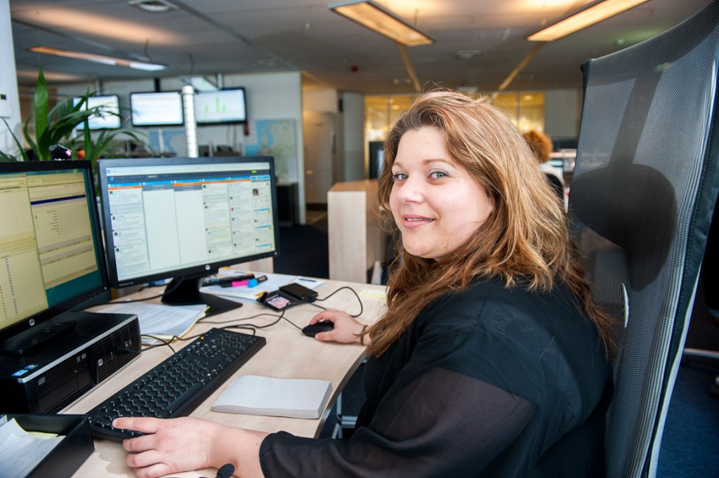
Your audience in corporate setup
Managers / directors | Communication professionals | IT & procurement

Slide 30
Understanding managers directors
Their responsibilities
Representation company
Vision & Strategy How does the world look like tomorrow? And what role does my company wish to play?
Tactics How are we going to accomplish that and what does the company need? Great people, money, marketing….
What are dangers? Competition, changing world…

Slide 31
Understanding communication professionals
Their responsibilities & work
Communication strategy and execution
Operational
Website takes lot of time, often tech
Amazing work load
Directors dropping bombs
Impossible deadlines
Legal demanding immediate changes
Reporting on effectiveness
Cut costs

Slide 32
Understanding IT
Their responsibilities & work
Must work and be fast
Must be secure
Must be future proof
Employees asking new software & hardware
Compliance
Audits
They don’t need another problem
They wish they could be proud of their gear

Slide 33
Offer

Slide 34
Weapons to position DNN
Most used .NET CMS
By far most used open source .NET CMS
Recognized as the most user friendly CMS
Microsoft invests billions / year on security, fixes and development
.NET is backed by company that has a sophisticated view on webtechnology
DNN has a great community, active professionals
Suitable as
CMS for websites, e-commerce, intranet, extranet, landing pages etc
Connection with back office (ERP, CRM, finance etc)
Multi channel content (headless cms)

Slide 35
Basic messaging
Representation company
Vision & Strategy How does the world look like tomorrow? And what role does my company wish to play?
Tactics How are we going to accomplish that and what does the company need? Great people, money, marketing….
What are dangers? Competition, changing world…
Managers / directors

Slide 36
Basic messaging: managers directors
Your company
understands their vision. Your solutions / proposal support that vision.
Don’t sell DNN, sell a vision, be a partner, not a supplier, transcent operational level.
DNN
Is being used by great companies
Is an award winning platform
.NET is backed up by IT, procurement, communication etc.
Capable professionals available for hire
Concept & technology should be flexible. 5 Years is mid term for business but light years in tech.
Notes:
(if you choose another platform that does not recognize this, you take a huge risk)

Slide 37
Companies using DNN
Health care
Finance
Science
Notes:
Lincare.com
Spine.org

Slide 38
Companies using DNN
Government
Consumer
Mobility
Notes:
Lincare.com
Spine.org

Slide 39
Basic messaging
Strategy and execution
Website takes lot of time, often tech
Amazing work load
Directors dropping bombs
Impossible deadlines
Legal demanding immediate changes
Reporting on effectiveness
Cut costs
Communication

Slide 40
Basic messaging: communication professionals
What they need to hear
DNN offer the most control
DNN offers the most freedom
DNN is the only editor in context
Short time to market (subsite within a day)
Support of sub brands (corporate, marketing, powered by…)
Delegate tasks to colleagues without fear
Supports SEO out of the box
Hundreds of extensions
Trusted vendors
Vision on liquid content / media independent publishing
Active community

Slide 41
Actually: don’t tell. Show!
My top 13 most impressive to show
Explain simplicity admin bar
Show inline editing
Create 15 pages (3 levels) in 1 click
Switch theme (corporate – sub brand – marketing)
Switch container
Add a module a page
Switch to another pane
Worry free complex layout editing (2SXC)
Compare content (Live HTML)
Form with dependencies (ActionForm)
Create a new subsite
Create a new site, using the site wizard
Timer on modules

Slide 42
Basic messaging
Must work and be fast
Must be secure
Must be future proof
Employees asking new software & hardware
Compliance
Audits
They don’t need another problem
They wish they could be proud of their gear
IT

Slide 43
Basic messaging: IT & procurement
What they need to hear
Solutions fits in overall architecture (.NET)
Has option for Azure / cloud
Roadmap to .NET Core
Vision on microservices
Open source (no fee at start, no fee for growth)
Secure
No vendor lock-in
Company for roadmap
Lot of professionals in store
Lot of professionals in community
Believable migration paths (VB – C# - MVC - .NET core)
Cheap / affordable

Slide 44
All lined up
Time for the kill

Slide 45
The curve ball
We all want one more thing
And…
You need a hook. That’s what they’ll remember when you’re gone

Slide 46
The curve ball
Is out of the box
Embraces their vision / want / need and goes beyond
Demonstrates passion
Often inspired by authority example
Plays with scope: zoom in on niche or zoom out for ultimate big picture

Slide 47
The curve ball: example 1, big picture
Customer wanted a platform to offer e-learning
We knew:
They have international ambitions
Many (freelance) producers of content
The curve ball: our concept offers flexibility.
Yes, you can have your platform to offer e-learning.
But…for phase 2
it can be a platform where producers can offer their e-learning.
You orchestrate the coherence and guard quality/safety
Schools/students can purchase
You charge 15%-25% of the purchase
You have your own App market

Slide 48
The curve ball: example 2, zoom in
Customer wanted a new website transferred as their Joomla was hacked.
Curveball: don’t want a new website. Just transfer as is and be safe NOW. Every day you play with safety, you play with trust. Next fase can be a new design. Content / design separation
Communications: Your site can be safe while you still can do your job. DNN has won awards for the most user friendly CMS.
IT DNN is recognized for its safety, fits in you MS environment Every year we have 3 customers have a pen test. Up to date passed with flying colours Microsoft invests billions per year to keep the technology safe

Slide 49
The curve ball: example3, refer to …
Customer wanted a website that helps people find a museum of their interest. But also inspired or even surprised. I would never have thought of that…
Look modern
Offer great search
Browse for orientation
Expert search for those who know what they want.

Slide 50
The curve ball: example3, refer to trends
Curve ball: Anyone can do this. Any CMS can do this. What you really need is brilliant UX. Why?
We get 60.000 visual impressions per day and getting busier every day
Instant gratification: we want answers now
Like Facebook or Shazam we choose 1 use case and be extremely good at it
Have all search results in images (interpretation time 8x faster)
Connect with Facebook. Get their likes, their friends likes and match with musea of their interest.
The website hand picks their crown jewel from hundreds of treasure rooms.

Slide 51
One more thing
NLP

Slide 52
Neuro Linguistics Programming
You can control your prospect with language / communication
Mirror techniques
Use of words
Use of voice
Use of pace
http://www.nlplifetraining.com/how-to-make-the-sale-with-nlp

Slide 53
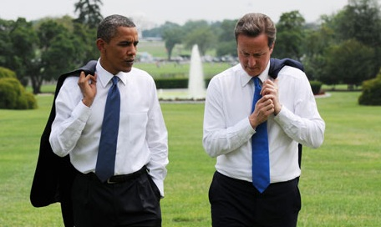
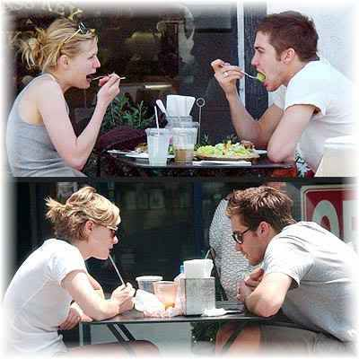
Mirroring
Notes:
People who like each other mirror. You can do this in acting or use of words

Slide 54
Use of words / voice
Customer: I now have a CMS that is not flexible. We have to turn to our supplier every day.
Somewhere down the line you drop: “DNN is awarded by users and experts for its flexibility. “
When reaching points you want to stress:
Pause
Lower voice, talk slower
Use the word important (it alerts)
It seems silly but it works.
Notes:
Use the word important (it alerts)

Slide 55
Use of words / voice
Don’t just use it in pitches
Use it in your offering and emails
So, find out what type of customer you have.
Innovation, future, amazing, next gen…
Secure, Proven technology, often tested
Easy, fast, cheap,
It seems silly but it works.
Notes:
Use the word important (it alerts)

Slide 56
Thank you

Slide 57
Cross selling / upselling
Using agile

Slide 58
Where money is lost
That’s not what I wanted
If course not like this
I don’t care about the functional design, in the original brief it said…
That is not the level that you should want to deliver
I can not imagine that you want to charge for such a tiny thing in a large project. This kind of stuff should be possible
O no, that’s not it, switch it back
This used to work…
New ideas that come along the way and are not addressed as such
Notes:
Use the word important (it alerts)

Slide 59
In agile scrum you
Agree on what the website should do on a global level
Break it down in user stories
Estimate those user stories
Prioritize
Draw a line where the budget ends
Now the magic
Notes:
Use the word important (it alerts)

Slide 60
Every week
Check on what’s new
Estimate that
Pull out of sprint planning
Check what’s different
Estimate that
Pull out of sprint planning
Prioritize again
Check where the budget ends now
Discuss what should be done
Accept the new scope
Increase budget
Notes:
Use the word important (it alerts)

Slide 61
In my experience
This method gives feedback every week
On progress
On budget
Gives the customer a sense of control. You work together, so he/she is an accomplice
Notes:
Use the word important (it alerts)

